Slide 1
Bredth First Search
Presented By :-
Sumant Kumar(20CE10074)
&
Sumit Nirmal (20CE10075)

Slide 2
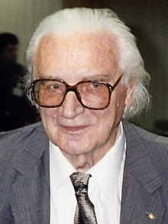
Inventer Of BFS
BFS were origionaly invented in 1945 by Konrad Zuse.
He was a German Civil Engineer,inventer and computer pioneer.
His greatest achievement was the world’s first prpgrammable computer.
Konrad Zuse

Slide 3
What is Bredth First Search (BFS)?
Bredth-first search (BFS) is an algorithm for traversing or searching Tree or Graph data structures.
It start at the tree root or some arbitrary node a graph,sometimes referred to as a ‘search key’ and explores all of the neighbor noides at the present depth prior to moving on to the nodes at the next depth level

Slide 4
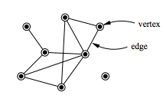
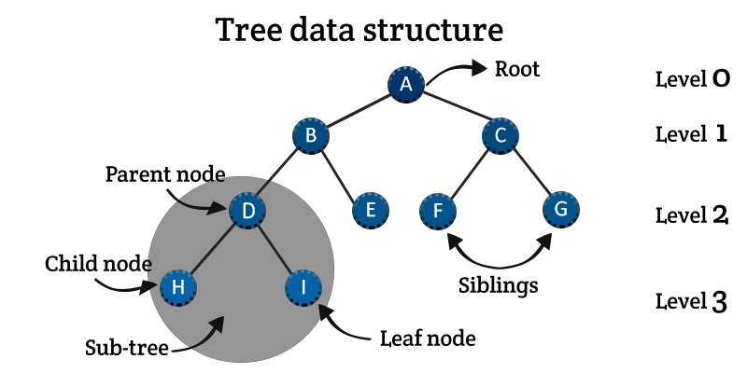
We Should know
→ A Graph G =(V,E) consists a set of vertices, V, and a set of edges, E.
→ A tree is a collection of entities called nodes. Nodes are connected by edges.Each node containes a value or data ,and it may or may not have a child node
→ Tree is also a Graph

Slide 5
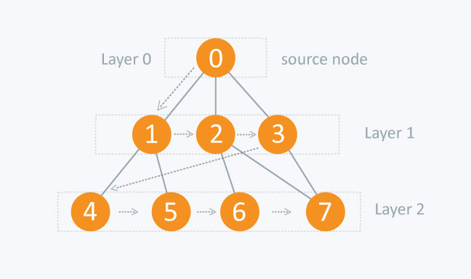
We Should know
→ Visiting a Vertex : It means going on a particular vertex or checking a vertex’s value.
→ Exploration of Vertex : It means visiting all the adjacent vertices of a selected node.
→ Traversing : Traversing means passing through nodes in a specific order
→ Level-Order : It is a traversing method, where we have to visit every node on a level before going to a lower level

Slide 6
BFS is just like Level Order & it follow 3 simple rules
Rule 1 ; Visit the adjacent unvisited vertex. Mark it as visited.
Insert it in a queue & Display it..
Rule 2 : If no adjacent vertex is found,remove the first vertex from the queue.
Rule 3 : Repeat Rule 1 and 2 untill the queue is empty.

Slide 7
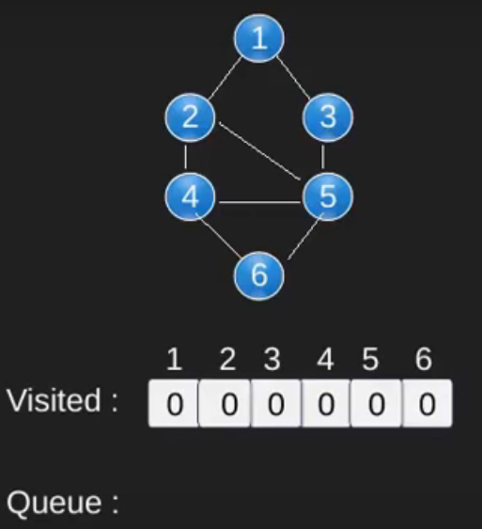
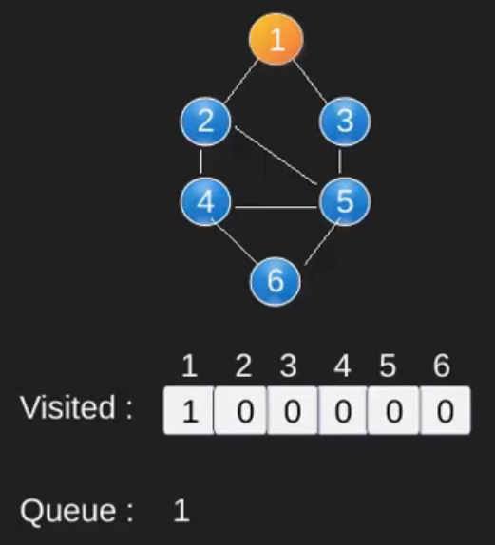
BFS example :
Fig. 1
Fig. 2

Slide 8
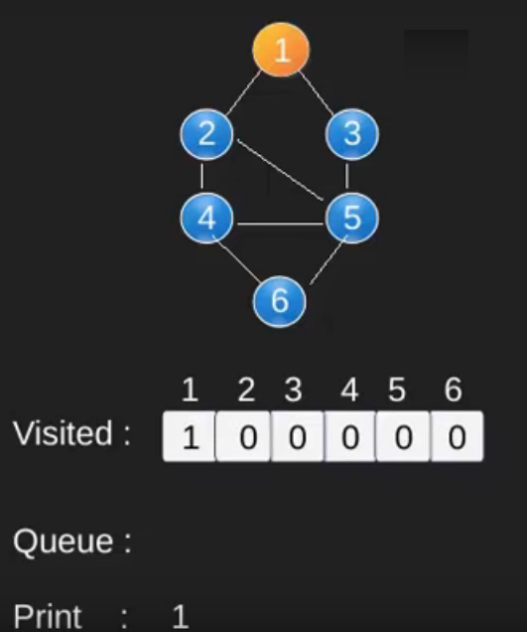
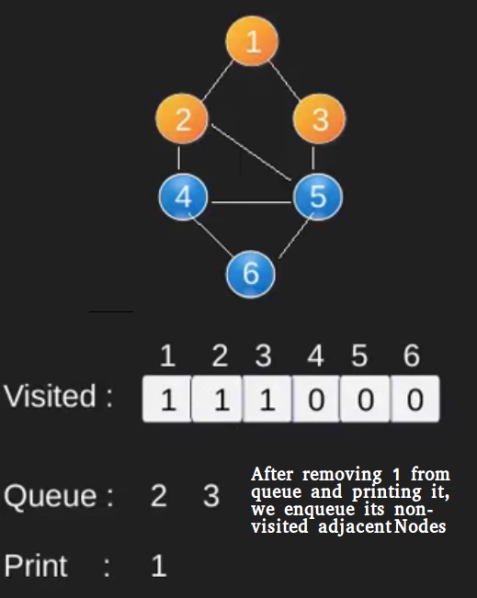
BFS example :
Fig. 3
Fig. 4

Slide 9
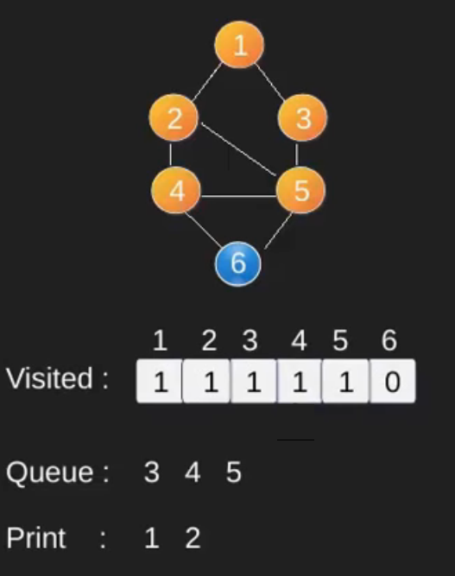
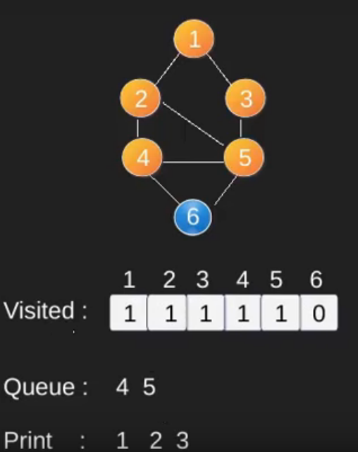
BFS example :
Fig. 5
Fig. 6

Slide 10
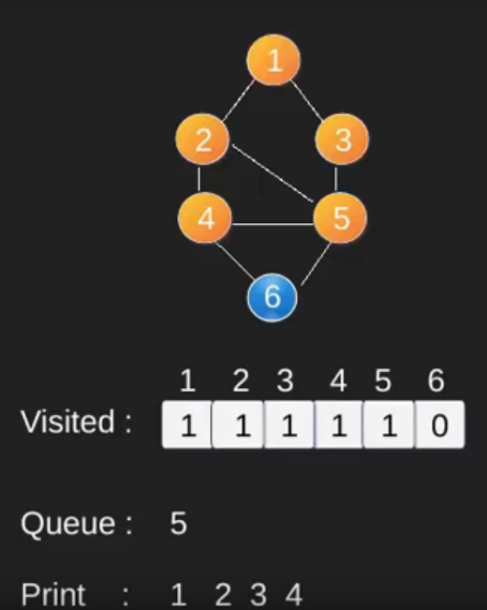
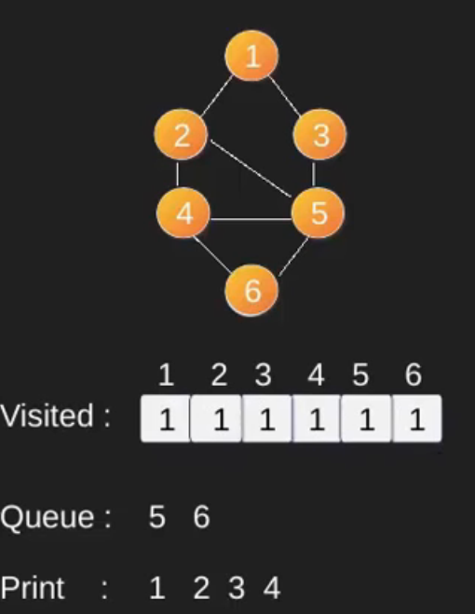
BFS example :
Fig. 7
Fig. 8

Slide 11
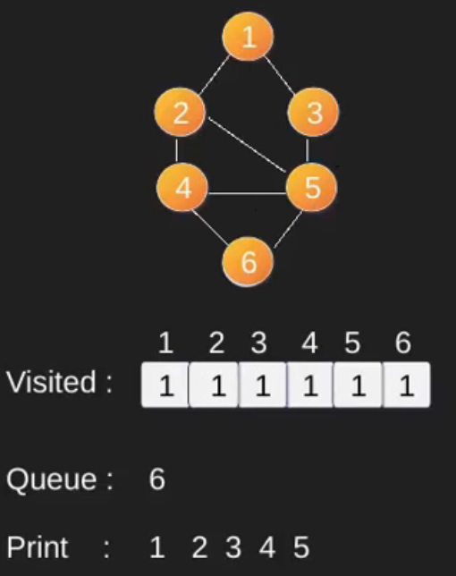
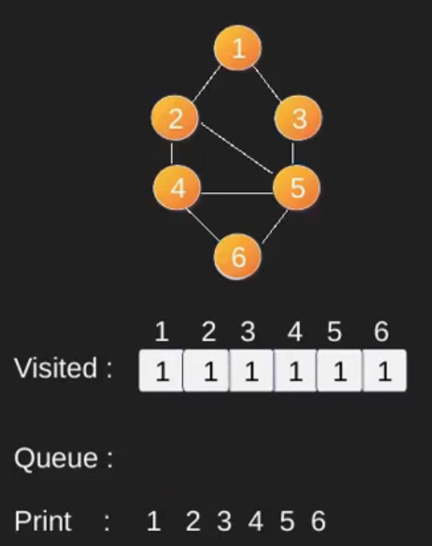
BFS example :
Fig. 9
Fig. 10

Slide 12
Applications of Bredth First Search
1. Shrtest Path and Minimum Spanning Tree for unweighted graph : In unweighted graph, the shortest path is the path with least number of edges. With Breadth First, we always reach a vertex from given source using the minimum number of edges,Also, in case of unweighted graphs, any spanning tree is Minimum Spanning Tree and we can use Bredth first traversal for finding a spanning tree.
2. Peer to Peer Networks : In Peer to Peer Networks like BitTorrent,Bredth First Search is used to find all neighbor nodes.

Slide 13
Applications of Bredth First Search
3.Crawlers in Search Engines : Crawlers build index using Bredth First Search .The idea is to start from source page and follow all links from source and keep doing same
4. Social Networking Websies : In social networks, we can find people within a given distancee ‘k’ from a person using Bredth Firsst Search till ‘k’ levels.
5. GPS Navigation systems : Breadth First search is used to find all neighboring locations. navigation systems such as the Google Maps,which can give directions to reach from one place to another use BFS. They take your location to be the source node and your destination as the the dstintion node on the graph. BFS is applied and the shortest route is genrated whiich is used to gave directions or real time navigation.

Slide 14
Applications of Bredth First Search
6.Broadcasting in network : In networks, a broadcasted packet follows Breadth First Search to reach all nodes.
7. In Garbage Collection : BFS is used in copying garbage collection
8.Cycle detection in undirected graph: In undirected graphs,either Bredth First Search o Depth First Search can be used to detect cycle . In directed graph, only depth dirst search can be used.
9.Path Finding: We can either use BFS or DFS to find if there is a path between two vertices.

Slide 15
THANKS

